Slide 1
SIX-POINT PROGRAMME/MOVEMENT
Prepared By Mallika Datta Lecturer at EDS
United International University

Slide 2
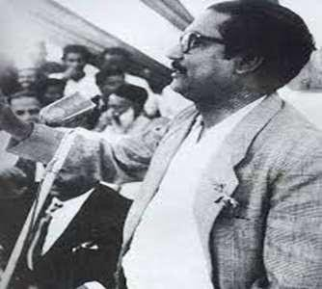
INTRODUCTION
Six-point Program a charter of demands enunciated by the AWAMI LEAGUE for removing disparity between the two wings of Pakistan and to put an end to the internal colonial rule of West Pakistan in East Bengal. Six-Point Program is called as – “The charter of freedom to the Bengali Nation. Sheikh Mujibur Rahman, the Awami
League President unfolded a Six Point Program on 13 February, 1966.

Slide 3
Background
Despite the many development efforts during the Ayub regime, the essential disparity between the two wings of Pakistan were not properly addressed. As a result, the feeling of discrimination continued to grow among the people of East Pakistan. The Six Points Movement, an anti-Ayub political movement gathered momentum and was a popular reflection of this discontent.

Slide 4
Proposed By
After the death of H. S. Suhrawardy in 1963, the leadership of the Awami League was taken over by Sheikh Mujibur Rahman. Under his leadership, the Awami League soon became one of the most popuular and strongest political parties in East Pakistan.

Slide 5
Time and Place
On 5 February 1966, at the Lahore conference, Sheikh Mujibur Rahman announced his six-point political and economic program for East Pakistan provincial autonomy. It was published under the title "Six Point Formula-Our Right to Live“ on March 23, 1966.

Slide 6
Six Point
point 1
The Constitution should provide for a Federation of Pakistan in its true sense based on the Lahore Resolution, and the parliamentary form of government with supremacy of a Legislature directly elected on the basis of universal adult franchise.

Slide 7




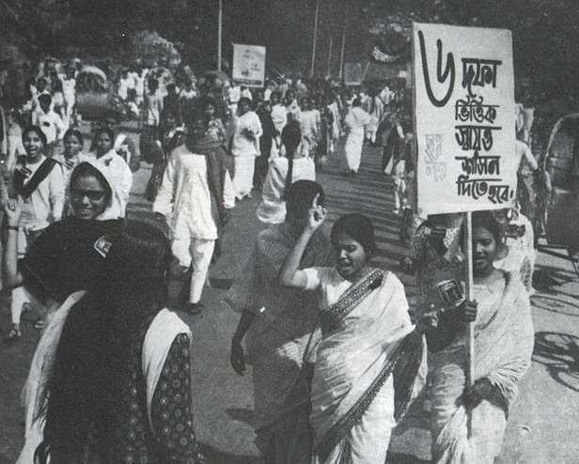


POINT 2
The federal government should deal with only two subjects: Defence and Foreign Affairs, and all other residual subjects should be vested in the federating states.

Slide 8
Six Point
3. There will be two separate freely convertible currencies in the two regions of the country: or one single currency for the whole country with the provision of two reserve banks in two provinces under a Federal Reserve banks.

Slide 9
4. The power of taxation and revenue collection should be vested in the federating units and the federal centre would have no such power. The federation would be entitled to a share in the state taxes to meet its expenditures.

Slide 10
Six Point
5. There should be separate accounts for the foreign exchange of the two regions. If necessary, the requirement of the Centre will be met by the two regions on the basis of equal rate or as specified in the constitution.

Slide 11
Six Point
6. The federal states should have the authority to form regional armed forces or militia or para militia forces to protect the territories.

Slide 12
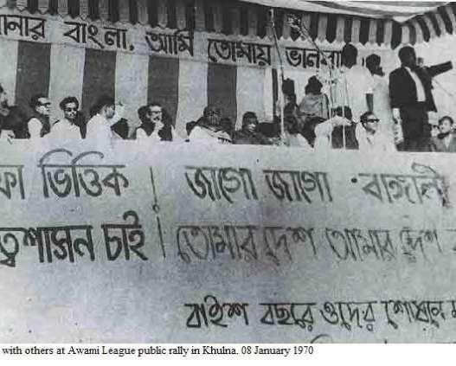
POINT 6
East Pakistan should have a separate military or paramilitary force, and Navy headquarters should be in East Pakistan.

Slide 13
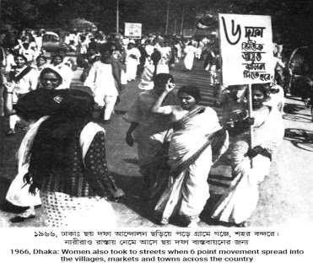
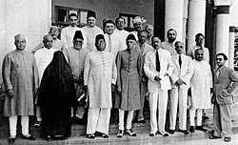

Political parties and 6 point movement:
The Council Muslim League
called the programme „nothing but the programme for the separation of East Pakistan
The Nizam-i-Islam & Jammat-I
–Islam rejected the programme
June 7 in
League
1966 the Awami
called a
The National
Awami Party the Six Point
(NAP) ignored
Programme on the ground
countrywide hartal.
and blamed Mujib for his
unilateral and dictatorial move.

Slide 14
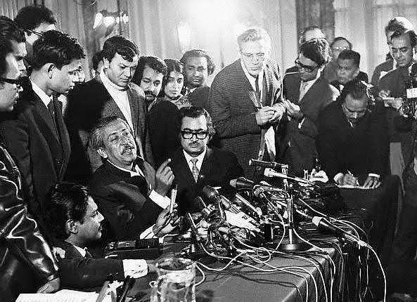
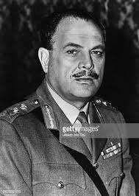
Reaction of West Pakistan on 6-Point Movement
President Ayub remarked that it is the conspiracy for establishing a Hindudominated United Bengal
The press in West Pakistan described it
as cessasionist agenda.

Slide 15
It Was supported by People because-
It threatened the political and economic monopoly of West Pakistan.
East Pakistan's export earnings would no longer be manipulated for industrialisation of West

Slide 16
It Was supported by People because-
East Pakistan would no longer be exploited for maintaining the vast war machine of West Pakistan.
Economic priorities would no longer be determined for the advantage of West Pakistan.
It would end the dominance or West Pakistani bureaucrats.

Slide 17
It Was supported by People because-
“Six Points movement was the charter of Liberation of Bengali nation”–

Slide 18
Historical significance of 6-point movement
As a result, the economists, intelligentsia, and the politicians of East Pakistan started to raise questions
about this discrimination, giving
rise to the historic six-point movement. The
The six-point demand is a milestone event in the history of Bangladesh.

Slide 19
Significance
The six-point movement was the precursor of some momentous events which were the triggering factors of the emergence of Bangladesh.

Slide 20
Demand for Autonomy
Six-point demand was first identified East Bengal as a separate region and demanded greater autonomy.

Slide 21
Bengali Nationalism
The six points were a symbol of hope and aspiration of Bengalis. This was the key to the characterization and self-reliance of the Bengali nation consisting of Hindus, Muslims, Christians and Buddhists in East Pakistan. As a result, the six-point movement was severely suppressed and the consciousness of the Bengali nation united them.

Slide 22
Popularity of Awami League and Sheikh Mujibur Rahman
Sheikh Mujibur Rahman presented the six-point demand on behalf of the Awami League in 1966. As a result, the popularity of Sheikh Mujib and Awami League increased through six points. According to Raunaq Jahan, “ Six point movement whose main thrust was demand of greater autonomy for east Pakistan is regarded as the turning point in Mujib’s rise to charismatic leadership ’’.

Slide 23
Voice against exploitation
The six-point demand was the first strong protest against the long-running exploitation of East Pakistan by the Pakistani government. Sheikh Mujibur Rahman himself referred to the six points as "the Charter of Liberation of Bengal's peasants, workers, laborers, middle class and the common people to step towards the establishment of Bengal's rights".

Slide 24
Voice against exploitation
Six points awaken democratic values.
Six point played an important role in the Agartala Conspiracy Case in 1968.
The removal of Ayub Khan's dictatorship.
Six point played an important role in the mass uprising of 1969.

Slide 25
Election of 1970
The key factor in Awami League's election manifesto in 1970 was this six points program. The Awami League sought public mandate in favor of the six points program in the general elections of 1970. A landslide victory was gained with the absolute mandate from the people of East Pakistan in favor of six-point program.

Slide 26
Seeds of Freedom
The seeds of Bangladesh's independence were sown in the six points. Because the first demand for autonomy was in the six points which helped the mass uprising in 1969 and the victory of Awami League in the election of 1970 which played an important role in the rise of independent Bangladesh.

Slide 27
Thank You

